Slide 1
Canon U.S.A.
Clarifying Direction for the Big Picture
Badrinath Batule, Ken McLean, Anwar Robinson, John Roller, & Gabrielle Scelsa
MGT 207 — Organizational Behavior and Leadership Skills For Strategic Advantage
HOFSTRA UNIVERSITY
Dr. Lauren C. Hindman, Professor
Spring 2024
Presentation Date: Tuesday, May 7, 2024

Slide 2
Table of Contents
Company Overview
Current Leadership Structure
Overview of Problem Statement
Experiences of Current Employees
Missing Effective Team Characteristics
Recommendations and Solutions through OB Strategies
Conclusion
References

Slide 3

Company Overview
Established in 1955
Leader in imaging and optical technologies
Headquartered in Melville, New York
Employs over 12,000
(Canon U.S.A., 2024)

Slide 4

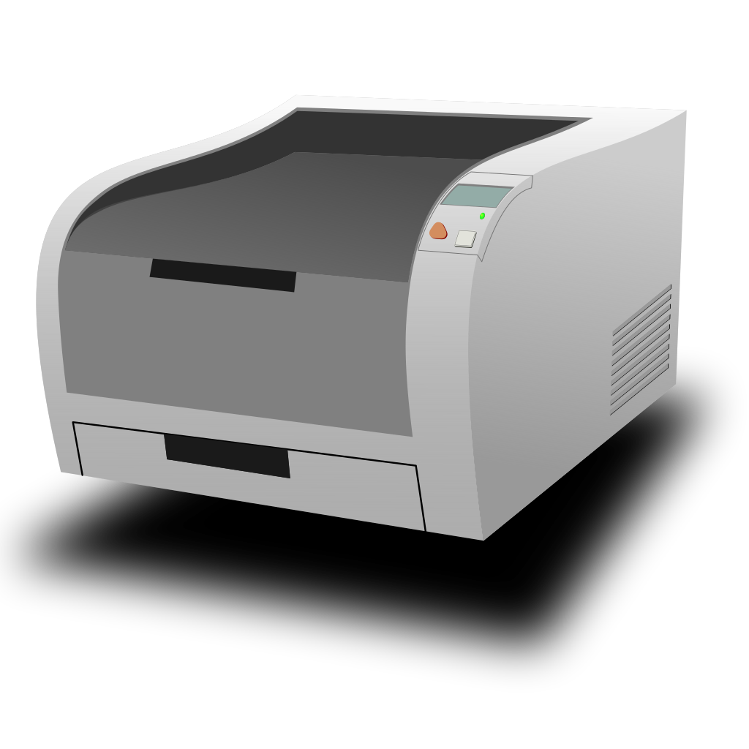
Products and Services
Provides innovative solutions for a wide range of consumers
Professional photographers, videographers
Everyday consumers and businesses
To accommodate this extensive brand image, their product portfolio includes a diverse array of offerings
Printing
Business solutions
Medical imaging
(Canon U.S.A., 2024)

Slide 5
Current Leadership Structure
Isao Kobayashi
President and CEO
Effective January 1, 2024
Seymour Liebman
Executive VP, Chief Administrative Officer, General Counsel and Secretary ( Promoted to VP in 1987)
Shinichi Yoshida
Executive VP and General Manager of the Business Information Communications Group; Chairman and Chief Executive Officer of Canon Solutions America, Inc. & Canon Financial Services, Inc. (2018)
Mason Olds
Executive VP of the Business Information Communications Group
Effective April 1, 2023

Slide 6

Overview of Problem Statement
Clarity needed for the Marketing Department to foster alignment with Canon’s goals
Department needs more explicit direction for short- and long-term initiatives
Employees need to be empowered to be fully connected with company’s goals
Notes:
Add specific examples of the problem

Slide 7
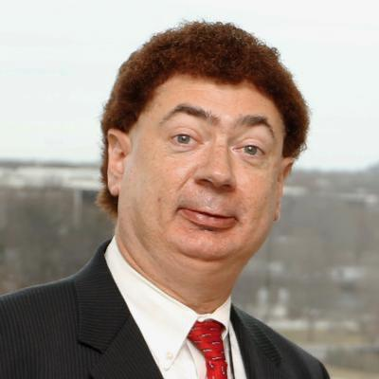
Experiences of Current Employees
Kevin Mattimore, Manager, Internal Communications, Corporate Communications Division:
Strategic guidance needed to clarify goals for Marketing Department (i.e., campaigns, projects, initiatives).
A CMO (Chief Marketing Officer) can help to shape department’s direction to avoid brand misrepresentation.
Notes:
Problems in the Marketing Department associated with Canon USA (Melville, NY) are outlined by experienced professionals in the department.

Slide 8
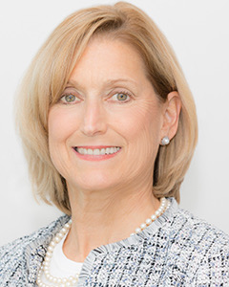
Experiences of Current Employees
Chris Sedlacek, Senior Director & General Manager, Corporate Communications Division:
Clear leadership needed to:
Prioritize Marketing Initiatives
Effectively Allocate Resources
Capitalize on Marketing Strategies and Channels
CMO can:
Drive Innovation
Align Marketing Strategies and Consumer Trends
Liaise with other departments
Keep main objectives in view and department on target
IS RETIRING on FRIDAY, 5.10.2024

Slide 9

Missing Effective Team Characteristics
Strong leadership
Clear and elevating goals
Coordination and Collaboration
Strategy and Planning
Leadership and Vision
(Hindman, 2024a, 2024e, & 2024f)

Slide 10
Organizational Challenges Connected to Departmental Performance
Departmental Leadership Needed
Without a CMO, or another leadership figure, Canon U.S.A. is struggling to be able to coordinate in a way that pushes them all towards the same result.
Improvement Needed for Interdepartmental Coordination & Communication
Limiting the flow of thoughts, ideas, and processes
Negatively impacting the ability to organize task efficiently and effectively
Communication Challenges
Employees are all on different pages when it come to creating a clear narrative & branding strategies for the company

Slide 11
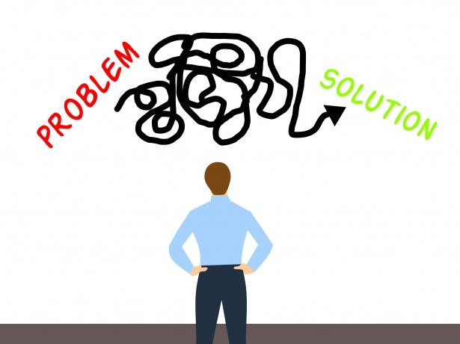
Recommendations
Implement C-Suite Position (CMO)
Focus on Leadership & Motivation
Unified Communication and Collaboration Solutions
(Hindman, 2024a, 2024b, 2024c, 2024d, 2024e, & 2024f)

Slide 12

Solutions through OB Strategies
Goals for fostering Motivation
Unify Department, maximize trust from other departments
Provide Autonomy to staff; allow contributions and collaboration in deliverables
(Hindman, 2024a, 2024e)
Notes:
In the New Year, Canon got a new CEO (Sammy Kobaychi); had seen that output from Marketing was not the best. Fostered more meetings in person and meeting in teams; hybrid meetings were not as effective. Employee recognition week occurred for the first time week of 4.29.2024. Simulated teamwork exercises. John received feedback, as he is the event planner and coordinator. Moving forward, there will be a monthly all-company meeting, C-Suite; they will be asked questions and receive feedback directly from the team. The theme was “beyond the boundaries”, now it is “Power of One”. Department and organization will be implementing these strategies.

Slide 13

Solutions through OB Strategies
Path-Goal Theory
Leadership Styles
Directive Leadership
Transformational Leadership
Participative & Servant Leadership
(Hindman, 2024e)
Notes:
These are the leadership styles that would embody what is needed, should the organization move in this direction structurally. While this is the obvious solution, there are alternative solutions to incorporate this in management training.

Slide 14
Solutions through OB Strategies
Embody Goals within new Leadership
Pending resource allocation, a new position can carry out these goals
Candidate should embody these characteristics and have proven leadership track record related to current department needs
(Hindman, 2024e)
Notes:
Directive Leadership

Slide 15
Leadership Impact on Motivation
Strong leadership that goes beyond supervision and control, requiring active cooperation.
Self-Determination Theory
Team-Building & Motivation
Cohesive Goals
Leader
Goals
Motivation
(Khan & Wajidi, 2019)
Notes:
This study emphasizes the need for strong teamwork to achieve a unified message. By fostering collaboration and team building exercises, the marketing department can work towards a cohesive brand narrative. In the absence of a central leader, individual marketing leads might feel demotivated or directionless. By implementing the study's recommendations, we can create a more collaborative and motivating environment, ultimately leading to a more engaged marketing team at Canon U.S.A.

Slide 16
Challenges & Alternatives for Leadership Position
Creating a CMO position is the most ideal direction for the company.
Some challenges for creating a new position:
Budget
Rationale
Succession Planning Interference
Alternatives
Incorporate Succession Plan for Current Managers
Training
Improve Communication Channels
Cost-Effective Corporate Restructuring
(Hindman, 2024c & 2024f)
Notes:
In lieu of a CMO, training current managers for upward mobility to meet the current leadership needs.

Slide 17
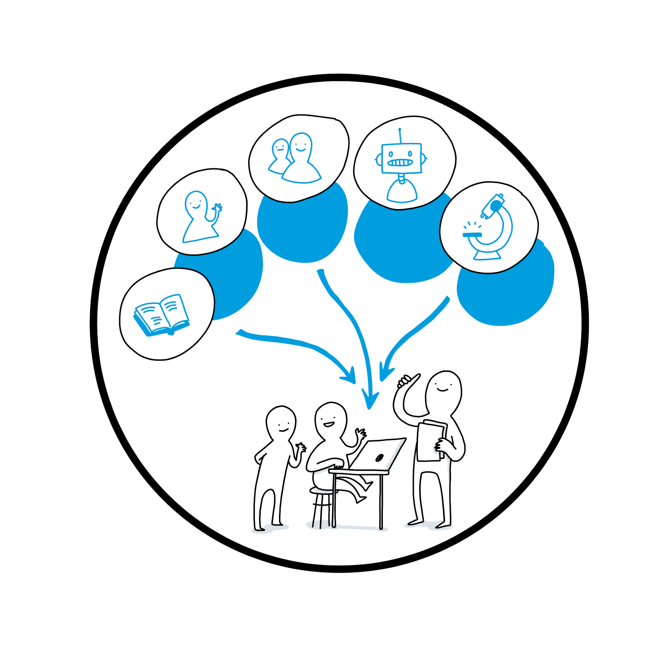
Solutions through OB Strategies
Clarify & Streamline Communications
Media Richness Theory states:
In-person Conversation and Meetings
Increase open communication and ensure all ideas are equally heard and given the same attention and respect
New marketing directives and Campaign ideas
Emails and Instant Messaging
Smaller questions of concerns that may arise while continuing to conduct the project.
Incorporate UC&C
(Hindman, 2024d)
Notes:
Org-wide, there has been communication issues (i.e., Marketing-wise: many different departments [selling various products], and multiple departments for EACH PRODUCT [vertical and horizontal mgt], directions in marketing hasn’t been clear (i.e., Marketing wants to market to Gen Z, but the story that ends up going out does not reflect the Marketing department’s original vision). Marketing’s message to the consumers is not clear…gets lost in communication.

Slide 18
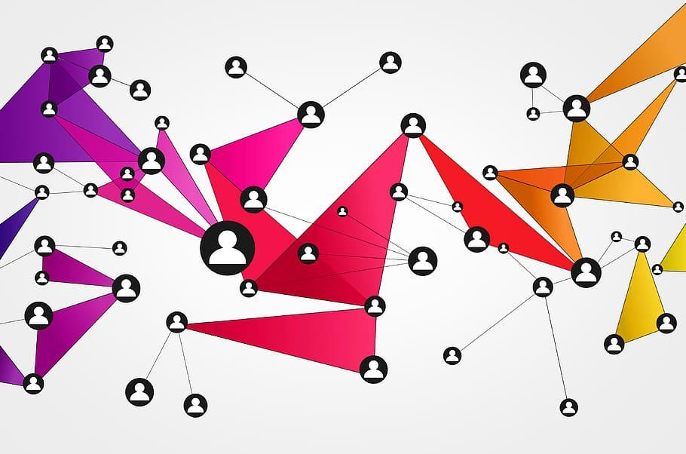
Ensuring Effective Collaboration
Unified Communications and Collaboration
Single Interface that incorporates all aspects of communication within a business for real time collaboration including:
Voice calling
Web Calls
Emails
Instant Messaging
(Bolton, Murray, & Fluker et. al, 2017) (Hindman, 2024d)
Notes:
The goal is that all departments are on the same page, from the initial stages of the product marketing to the target audience. The Marketing Campaign is currently not unified across the organization, and the absence of a CMO to advocate for the Marketing Campaign to be organizational is apparent here. It is predicted that UC&C implementation will increase productivity, encourage innovation, and improve collaboration within companies through digitally connected communication via virtual work environments.
To Canon’s benefit, this communication system is able to keep digital documentation of all communications, as well as produce communication reports that provide information about productivity, workflows, interdepartmental connectivity, and actualization of priorities.

Slide 19
Conclusion
The overall goals:
Improving the quality of the Marketing Department’s output
Creating a cohesive department brand narrative
Prioritizing motivation and restructuring the team
Improving and maintaining the health of the Marketing Department and its staff that will ensure its upward trajectory and vitality
Producing a sustainable and motivated workforce and boost morale within the company.
(Hindman, 2024)

Slide 20
Q & A
(Question & Answer)

Slide 21
References
Bolton, A., Fluker, J., & Murray, M. (2017). Transforming the workplace: Unified communications & collaboration usage patterns in a large automotive manufacturer. Hawaii International Conference on System Sciences.
Canon U.S.A. (2024). About Us [Website]. Retrieved on May 1, 2024 from, https://www.usa.canon.com/about-us
Hindman, L.C. (2024). Class #1: Intro to Organizational Behavior [PowerPoint slides]. Retrieved on January 30, 2024 from, https://hofstra.instructure.com/courses/26867/modules.
Hindman, L.C. (2024). Class #5: Job Performance & Motivation [PowerPoint slides]. Retrieved on April 16, 2024, from https://hofstra.instructure.com/courses/26867/modules.
Hindman, L.C. (2024). Class #6: Managing Teams [PowerPoint slides]. Retrieved on April 16, 2024, from https://hofstra.instructure.com/courses/26867/modules.
Hindman, L.C. (2024). Class #7: Communication [PowerPoint slides]. Retrieved on April 16, 2024, from https://hofstra.instructure.com/courses/26867/modules.
Hindman, L.C. (2024). Class #8: Leadership [PowerPoint slides]. Retrieved on April 16, 2024, from https://hofstra.instructure.com/courses/26867/modules.
Hindman, L.C. (2024). Class #10: Organizational Structure & Change [PowerPoint slides]. Retrieved on April 16, 2024, from https://hofstra.instructure.com/courses/26867/modules.
Khan, M.R., & Wajidi, A. (2019). Role of Leadership and Team Building in Employee Motivation at Workplace. Global Management Journal for Academic & Corporate Studies, 9(1), pp. 39-49.

